Slide 1
Problem Understanding and Representation
Zainab Yousuf

Slide 2
Content
Classical Approach/Generate and Test
Systematic Problem Solving approach
Problem Representation
Graph and Tree Terminologies
Problem Solving
Components of problem solving
Searching

Slide 3
AI as Problem Solving
Historically many people link intelligence with the capability to solve a problem.
Problem solving is one of the factors that demonstrate intelligence.

Slide 4
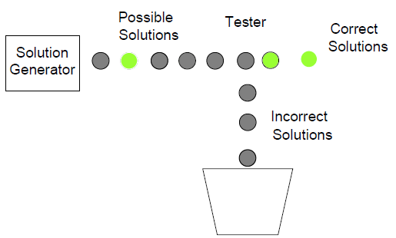
Classical Approach
The classical approach that is used is “hit and trial” that check for various solutions to that problem.
It is also known as ‘Generate and Test’ approach
We use this approach to solve small problems.

Slide 5
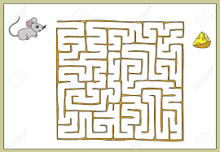
Classical Approach
Consider the maze searching problem.

Slide 6
Systematic problem Solving approach
For a simple problem or smaller problem we can use hit and trial approach to solve the problem. However when the problem is complex then we need a systematic way to solve the problem
The key to solve a complex problem is its representation.
Normally the problems are represented in the form of diagram (such as graph or trees).

Slide 7
Tree and Graph Terminologies
Graph
Tree
A graph is a set of nodes and arc/edges that connect them.
A graph is said to be directed if its arcs contain directionality using arrows.
If arcs do not contain arrow then this graph is known as undirected graph.
A tree is a graph in which two nodes have at most one path between them.
Trees often have roots that is why it is also known as rooted graph.
In tree cycles are not allowed which means that it is impossible for a path to loop or cycle continuously through a sequence of nodes.

Slide 8
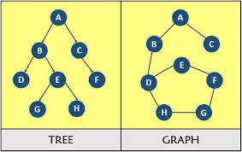
Tree and Graph Terminologies

Slide 9
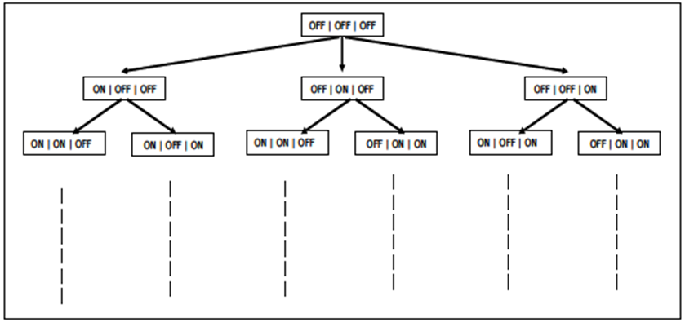
Problem Representation:
It shows the problem of switching on the light in a graphical form.
Each rectangle represents the state of the switch board.
OFF | OFF| OFF means that all the three switches are OFF.
OFF| ON | OFF means that the first and the last switch is OFF and the middle one is ON.
Starting from the state when all the switches are OFF the person can proceed in any of the three ways by switching either one of the switch ON.
This brings the person to the next level in the tree. Now from here he can explore the other options, till he gets to a state where the switch corresponding to the light is ON.

Slide 10
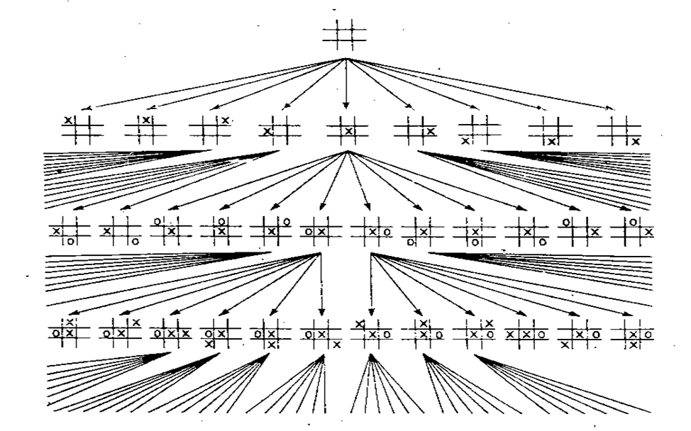
Problem Representation-Tic Tac Toe

Slide 11
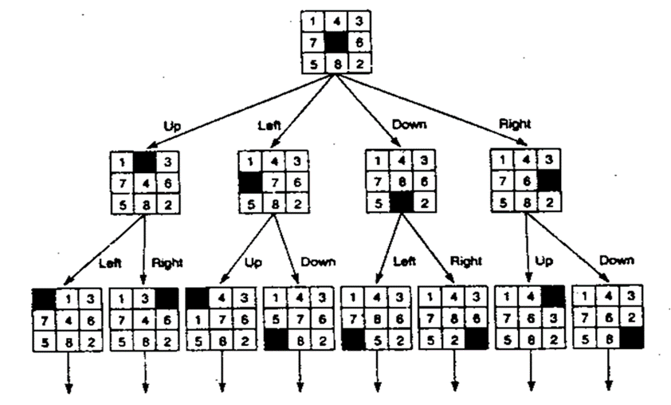
Problem Representation- 8-Puzzle Game:

Slide 12
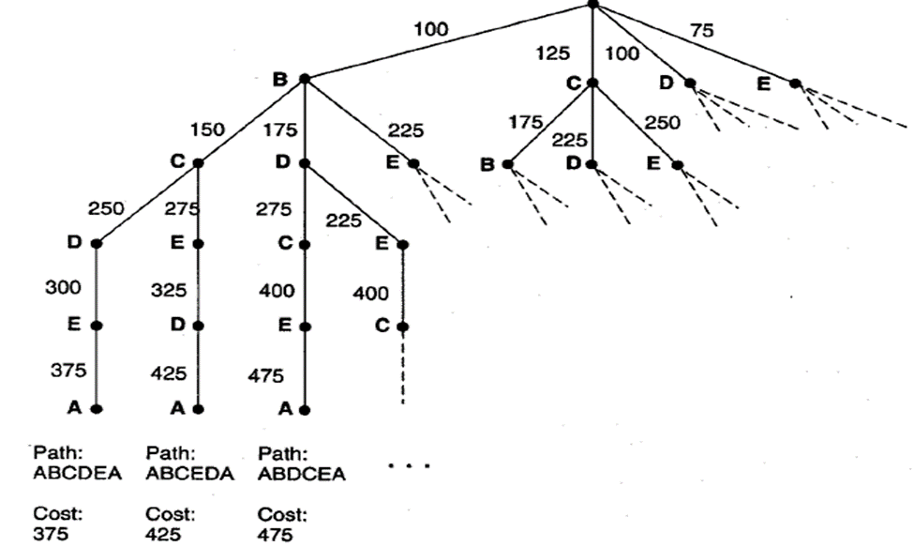
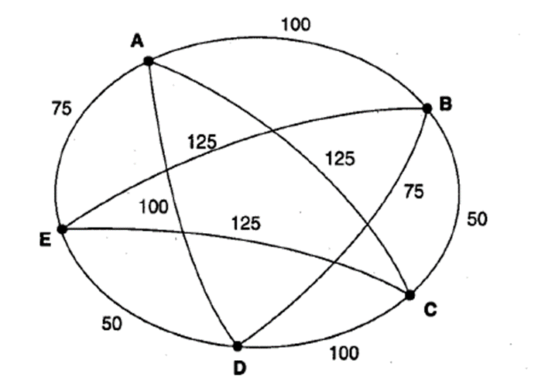
Problem Representation- The Traveling Salesperson
Suppose a salesperson has five cities to visit and then must return home. The goal of the problem is to find the shortest path for the salesperson to travel, visiting each city, and them returning to the starting city (A)

Slide 13
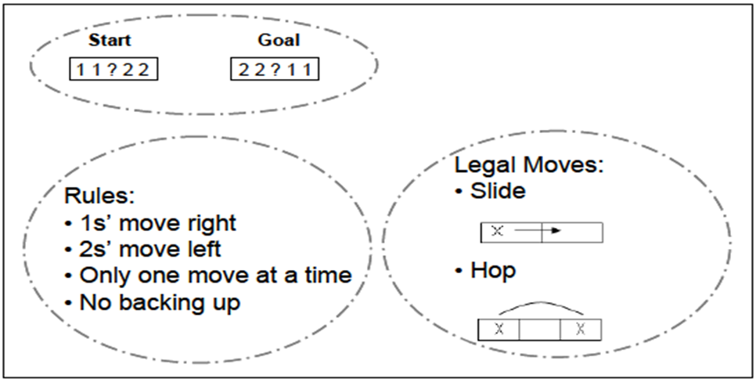
Problem Representation- The Two-One Problem
The two-one problem is a game in which the starting state is 11?22 and user needs to move these numbers’ slots left/right, by following the mentioned rules, to obtain sequence 22?11.
The above game can be better represented as a tree to find the possible solutions. A tree sort of structure enumerates all the possible states and moves. Looking at this diagram we can easily figure out the solution to our problem.

Slide 14
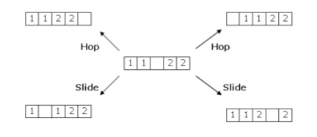
Problem Representation- The Two-One Problem
All possibilities of first state

Slide 15
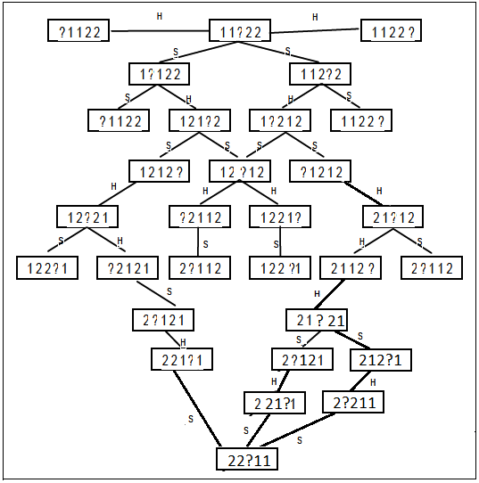
Problem Representation- The Two-One Problem

Slide 16
Components of Problem Solving:
Problem Statement: Problem at hand
Goal State: The destination
Search Space: The entire tree/graph
Operators: Rules/action to move in solution space
Once the problem is represented, the goal state can be searched in search space using different searching tactics

Slide 17
Searching
All the problems that we have looked at can be converted to a form where we have to start from a start state and search for a goal state by traveling through a search space.
Searching is a formal mechanism to explore alternatives.
If we can get our grips on algorithms that deal with searching techniques in graphs and trees, we’ll be all set to perform problem solving in an efficient manner.

Slide 18
Searching Strategies
Blind/uninformed
Depth First Search (DFS)
Breath First Search (BFS)
DFS with iterative deepening
Informed/heuristic
Best First Search
Greedy Approach
A* search
Any path/non-optimal
Optimal path search algorithms

Slide 19
Blind Search-Simple Back Tracking Algorithm
In solving a problem, a problem solver must find a path from a start state to a goal through the search space graph. Backtracking is a technique for systematically trying all paths through a state space.
SL: for state list, lists the states in the current path being tried, If a goal is found, SL contains the ordered list of states on the solution path.
NSL: for new state list, contains nodes awaiting evaluation, i.e., nodes whose descendants have not yet been generated and searched.
DE: for Dead end, list states whose descendants have failed to contain a goal node. If these state encountered again, they will be detected as element of DE and eliminated from consideration list.
CS: Current State.

Slide 20
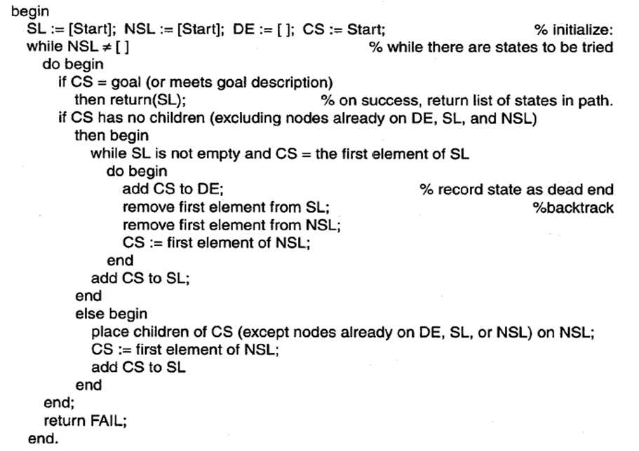
Simple Back Tracking Searching Algorithm

Slide 21
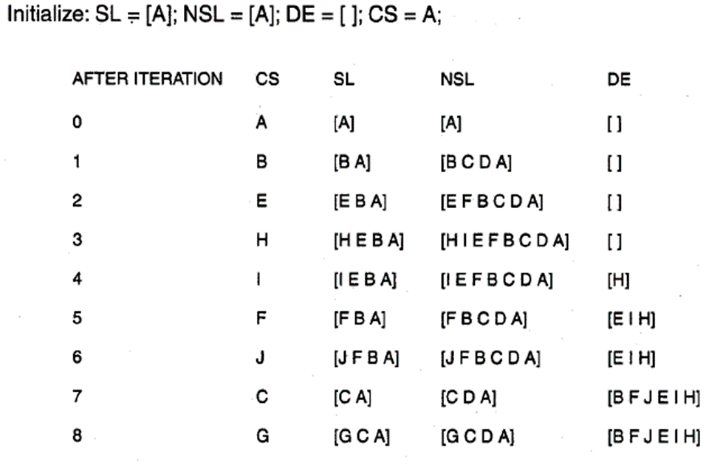
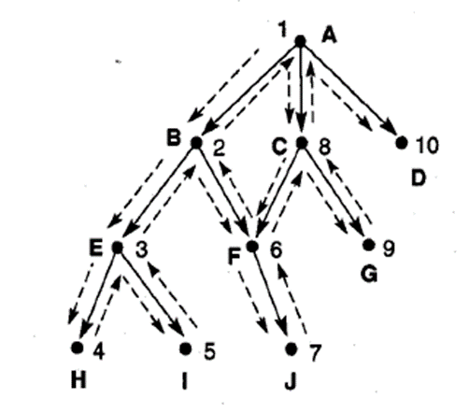
Simple Back Tracking Searching Algorithm

Slide 22
Assignment # 2
Depth First Search (DFS)
Breath First Search (BFS)
Compare DFS and BFS
Pros and Cons of DFS and BFS

Slide 23
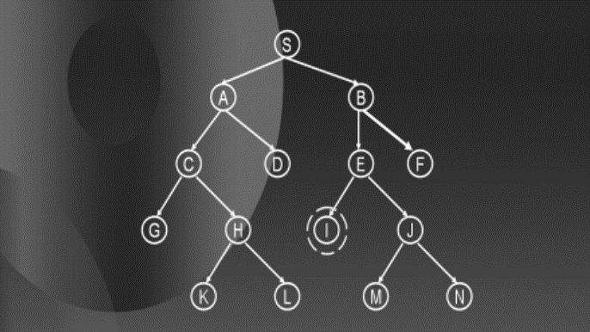
DFS with Iterative Deepening/Progressive deepening
Progressive deepening actually emulates BFS using DFS.
It simply apply DFS to a specific level.
If you find the goal, exit, otherwise repeat DFS to the next lower level.
Go on doing this until you either reach the goal node or the full height of the tree is explored.
For example, apply a DFS to level 2 in the tree, if it reaches the goal state, exit, otherwise increase the level of DFS and apply it again until you reach level 4.

Slide 24
Thank You

